Slide 1
EnsembleLens: Ensemble-based Visual Exploration of Anomaly Detection Algorithms with Multidimensional Data
Authors: Ke Xu, Meng Xia, Xing Mu, Yun Wang, and Nan Cao
Presenter: Long Dang (INTO USF)
Apr 03 2019
Acknowledgement: some slides are taken from authors’s online presentation.
Notes:
This template can be used as a starter file for presenting training materials in a group setting.
Sections
Right-click on a slide to add sections. Sections can help to organize your slides or facilitate collaboration between multiple authors.
Notes
Use the Notes section for delivery notes or to provide additional details for the audience. View these notes in Presentation View during your presentation.
Keep in mind the font size (important for accessibility, visibility, videotaping, and online production)
Coordinated colors
Pay particular attention to the graphs, charts, and text boxes.
Consider that attendees will print in black and white or grayscale. Run a test print to make sure your colors work when printed in pure black and white and grayscale.
Graphics, tables, and graphs
Keep it simple: If possible, use consistent, non-distracting styles and colors.
Label all graphs and tables.

Slide 2
Overview
Motivation
Main contributions
System overview
The model
Case study – Video demo
Q&A

Slide 3

Motivation
Notes:
This is another option for an Overview slides using transitions.

Slide 4
Motivation
Anomaly detection algorithm is applied in a wide range of domains: urban management (air pollution), health science(assess pains in new born babies), financial fraud detection,…
Data is multidimensional and specific to each domain

Slide 5
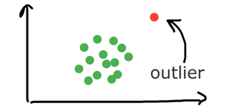
Anomaly detection
Anomalies are patterns in the data that do not conform to a well defined notion of normal behavior

Slide 6
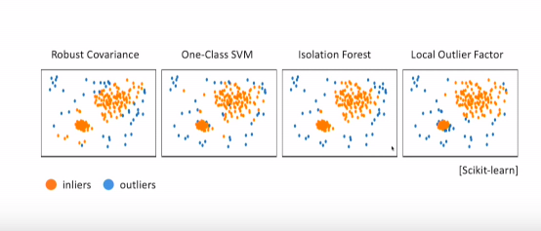
Anomaly detection algorithms

Slide 7
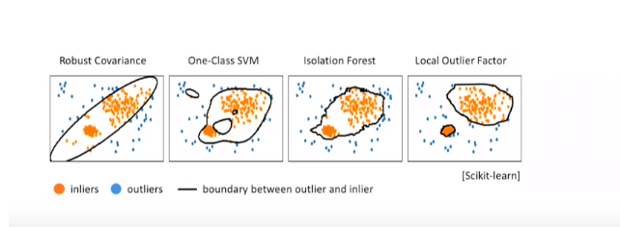
Problems
For a given dataset, different algorithms usually have different definitions of outliers

Slide 8
Problems
Because dataset is most of the times high-dimensional, the anomaly detection results is also sensitive to the choice of attributes/features.

Slide 9
Motivation
Research question: how can data mining experts find the proper anomaly detection algorithms for a given data set?

Slide 10
Main contributions

Slide 11
EnsembleLens
An integrated visual analytics system: visualize the correlation and weights between different anomaly algorithms
Interactive exploration:
Implement the overview – detail comparison – validation and reasoning visual analytics methods
Build evaluation based on user feedback
Efficient visualization designs:
Introduce a novel layout algorithm.
Effective evaluation:
Multiple forms of evaluation developed through case studies and meetings with data mining and researchers → standardized
work process and promising to go further!!!

Slide 12

System Overview

Slide 13
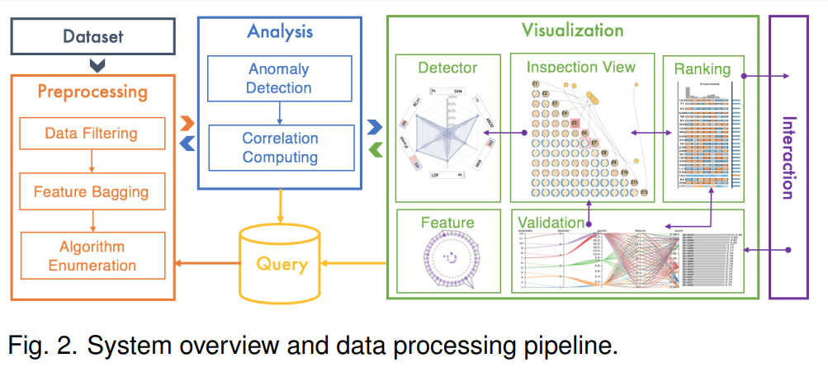
System Overview

Slide 14

The prepocessing module
Convert the raw data into multidimensional format
Enumerate the candidate algorithms

Slide 15
The Ensemble based analysis module
Run anomaly detection on the candidates
Compute the correlation between each other

Slide 16
The interactive visualization module
Explore and interpolate the ensemble based analysis

Slide 17
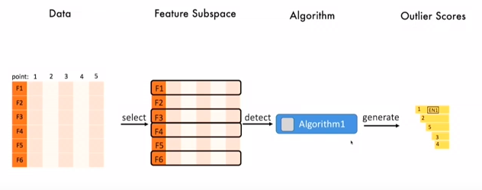
What is an ensemble component?
An algorithm has the specific parameter setting + a sample feature subspace. The output is the outliers score ranking of the input data.

Slide 18
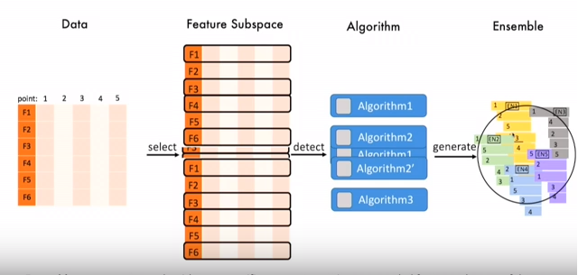
What is an ensemble component?
When there is more than one algorithm candidate, the ensemble analysis and ensemble technique are used to systematically selecting features of a species and combine them with different algorithms and then generate a batch of anomaly detection results.

Slide 19
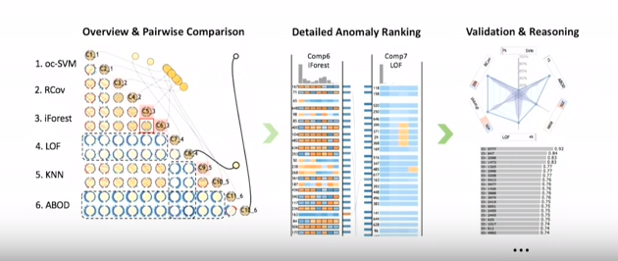
Visualization and workflow
Interactive
Design principle: overview to detail comparison, then validation and reasoning

Slide 20
The workflow and case study
Link with automatic English caption: https://www.youtube.com/watch?time_continue=779&v=ABsADlSk-gk
Starting from 6:09 - 14: 09 (8 minutes)
* Note: this video is on my Youtube account.
The original link is https://vimeo.com/300467897

Slide 21
Thanks you!!!
Thanks you for giving me this opportunity to present this interesting topic

Slide 22
Questions?

Slide 23
https://vimeo.com/300467897

